Slide 1

From Bench to Spin-Off: How to reach results able to be patented
Prof. Bruno Botta
Department of Chemistry and Drug Technologies
Sapienza University of Roma

Slide 2
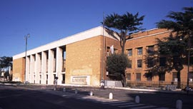
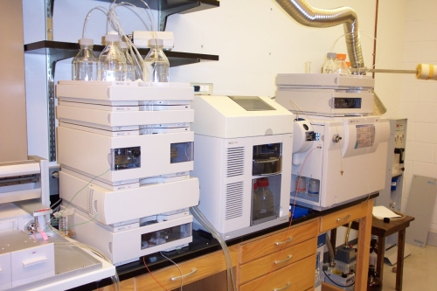
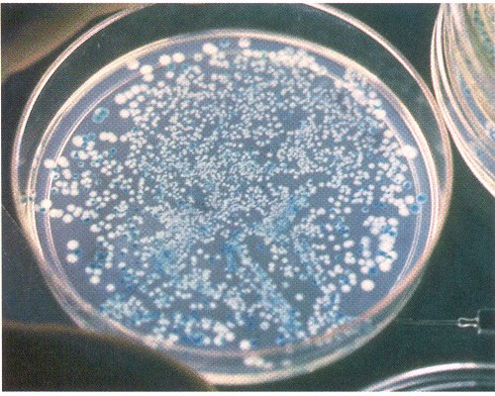

Molecular Links Rome is a spin-off company of the University “Sapienza” of Rome.
Chemistry & Biotechnology

Slide 3



Networking with innovative European PMIs
Collaboration agreements, profit share contracts, joint research projects with innovative PMIs and top level academic centers are at the basis of our business concept.

Slide 4
MoLiRom s.r.l.
Molecular Links Rome
Proprietary separation/purification techniques
Natural products libraries
Enzymes and bioreactors
Advanced in silico screening platform
Networking with innovative European SMIs

Slide 5
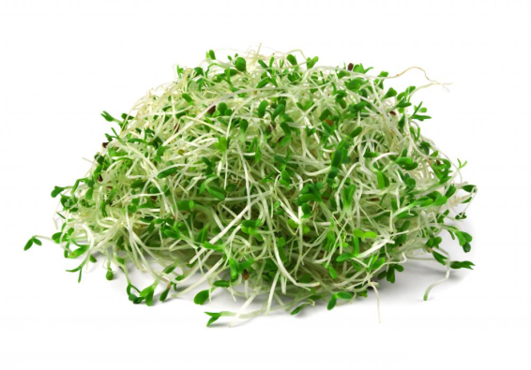
HISTAMINASE (DIAMINE OXIDASE, DAO) FROM VEGETAL ORIGIN
New active ingredient for food intolerance linked to histamine release from gut
Formulated as food grade powder
Possible indications for irritable bowel disease

Slide 6
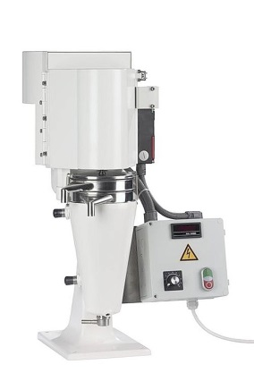
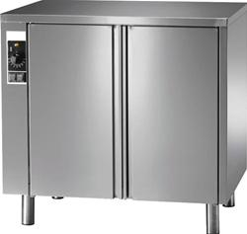
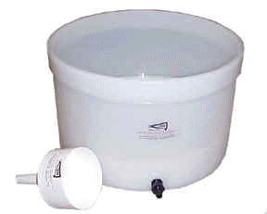
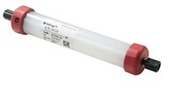
DAO PRODUCTION
Ambient chamber
Continuous centrifuge
Batch + Fine (akta)
Seedlings care
Extraction
Cromatographic
purification
IMPROVED PILOT FACILITY 2-4 Million Units / year

Slide 7
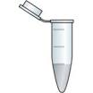


Other DAO applications
Diagnostic test for halitosis in saliva (detection of biogenic amines). Dry chemistry device.
Biogenic amines quantitative determinations in wine and beer, colourimetric analysis:
Key parameters for quality beverages !

Slide 8
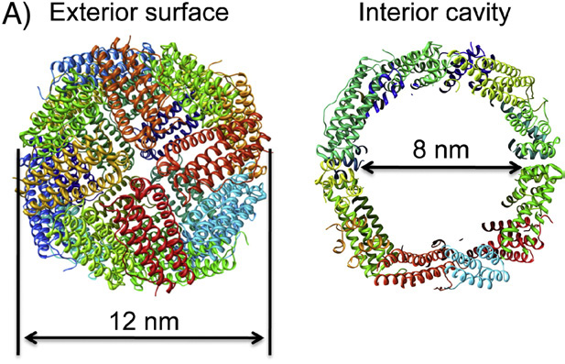
FERRITIN BASED SCAFFOLDS FOR NANOTECHNOLGY
Recombinant human ferritins for drug delivery and diagnostics
Thermostable ferritins for nanodot/nanophosphors assembly

Slide 9
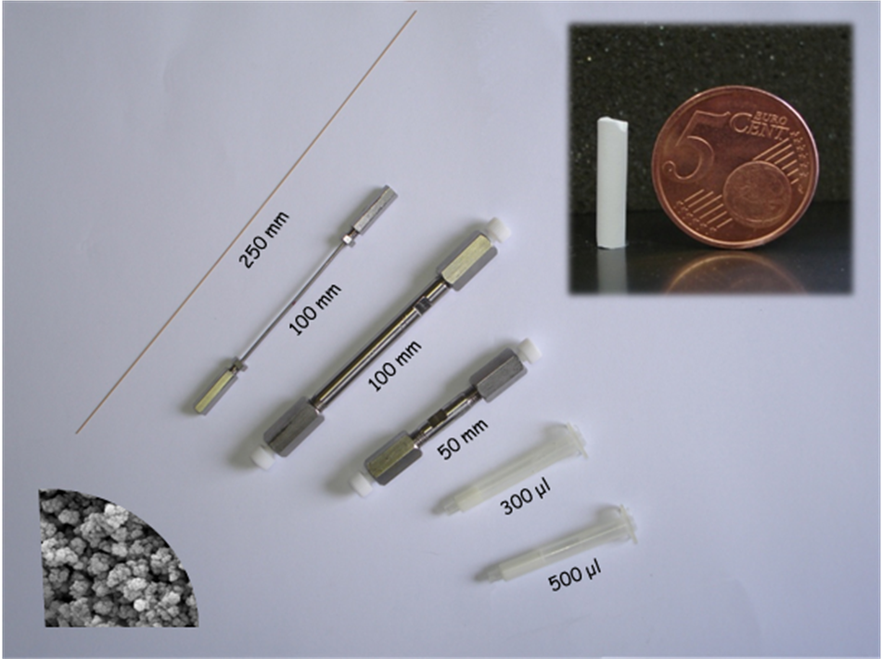
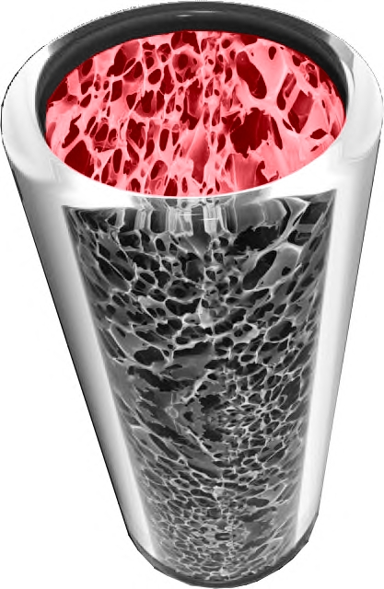
Proprietary separation/purification technologies
Capillary I.D. [150-530] μm
Nano I.D. [20-150] μm
I.D. 1.0-2.0 mm
I.D. 4.00 mm
I.D. 4.00 mm
SPE cartridges
MOnoLithic HPLC Columns Separation/purification of drugs, metabolites, pesticides, bioproducts, plasma proteins

Slide 10
Analysis of Erythropoietin
Monolithic Column
γ₄₀-ACR-RP-MD-08-06A
250x0.250 mm
Erythropoietin [c]:0.500 mg/ml
?
Eluents: A: H₂O/ACN 95/5 V/V+0,1% TFA, B: H₂O/ACN 5/95 V/V+0,1% TFA; Flow rate: 15.000 μL/min; ΔP: 132 bar
Pump: Dionex Ultimate 3000; Cell: 20nl; Vinj: 200 nl; T: 60°C, UV@214nm

Slide 11
Analysis of Erythropoietin
Packed Column
ACE C4 3μm 300Å
150x0.300mm
Erythropoietin [c]:0.500 mg/ml
?
?
?
Eluents: A: H₂O/ACN 95/5 V/V+0,1% TFA, B: H₂O/ACN 5/95 V/V+0,1% TFA; Flow rate: 3.000 μL/min; ΔP: 34bar
Pump: Dionex Ultimate 3000; Cell: 20nl; Vinj: 200 nl; T: 60°C, UV@214nm

Slide 12
Separation of Protein Mix
γ₄₀-ACR-RP-MD-37
column: 250x0.200mm
1. Ribonuclease A (0.0413 mg/ml) 2. Lysozyme (0.0421 mg/ml) 3. α-Lactalbumin (0.0397 mg/ml) 4. Myoglobin (0.0405 mg/ml) α-Chimotrypsinogen (0.0413 mg/ml) Ovoalbumin (0.0889 mg/ml) Total amount injected: 58.5 ng
 | Sample | t_{R} (min) | k’ app (l) | PWHH* |  |  | N_{app}/col | Asymmetry Factor (l) | Resolution (l)
 |  |  |  | (s) | (min) | (μl)
1 | Ribonuclease A | 10.91 | 11.26 | 6.6 | 0.11 | 0.99 | 58486 | 1.34 | -
2 | Lysozyme | 15.33 | 16.22 | 6.0 | 0.10 | 0.90 | 131564 | 1.15 | 25.39
3 | α-Lactalbumin | 17.23 | 18.36 | 6.6 | 0.11 | 0.99 | 125013 | 1.40 | 10.42
4 | Myoglobin | 18.42 | 19.70 | 8.4 | 0.14 | 1.26 | 97486 | 1.51 | 5.55
5 | α-Chimotrypsinogen | 19.06 | 20.42 | 6.6 | 0.11 | 0.99 | 173051 | 1.37 | 3.07
6 | Ovoalbumin | 22.64 | 24.44 | 9.0 | 0.15 | 1.35 | 128787 | 1.05 | 16.50
Eluents: A: H₂O/ CH₃CN, 95/5, v/v + 0.1% TFA; B: H₂O/ CH₃CN, 5/95, v/v + 0.1% TFA; Flow rate: 9.000 μL/min;
Pump: Dionex Ultimate 3000; Detection: UV @ 214 nm; UV Cell 20 nL ; T: 60°C

Slide 13
Analysis of Total Protein Extract of Human Neuroblastoma Cells by capLC
γ₄₀-ACR-RP-MD-08-06
column: 550x0.250mm
Sample: Total Protein Extract of
Human Neuroblastoma Cells
[c]: 3.57 mg/ml
Eluents: A: H₂O/ACN 95/5 V/V+0,1% TFA, B: H₂O/ACN 5/95 V/V+0,1% TFA; Flow rate: 10.000 μL/min
Pump: Dionex Ultimate 3000; Cell: 20nl; Vinj: 500 nl; T: 60°C, UV@214nm

Slide 14
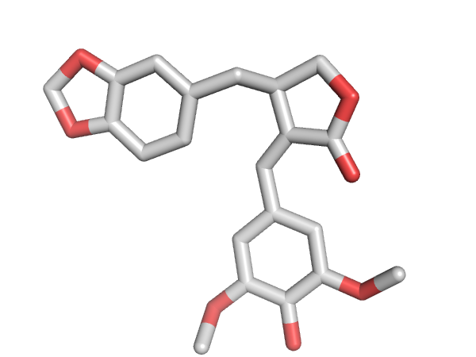
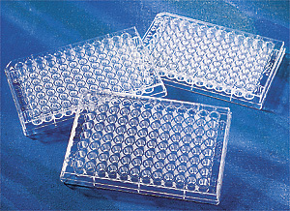
Natural products libraries
Over 900 bioactive natural products have been identified and characterized. These products can be made available for screening in pharma industry in the form of panel plates. De novo synthesis is also available.

Slide 15
Our molecular modeling strategy in drug design
The Structure of the target receptor is available (X-ray, NMR, homology modeling)
no
yes
Ligand-based approaches
(Chemoinformatics, clustering of compounds library)
Structure-based approaches
(Virtual screening, rational design, Molecular Dynamics)

Slide 16
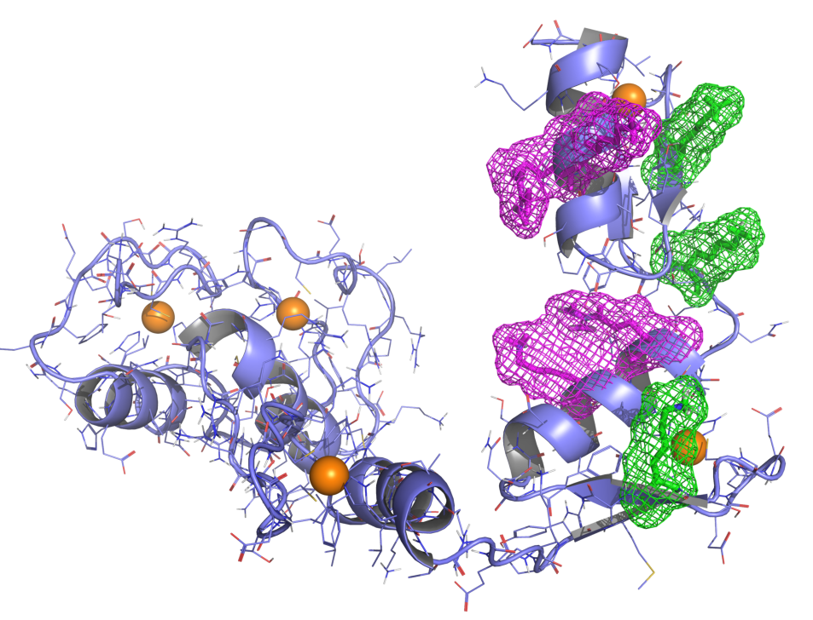
Example of Structure-based approach – Hedgehog inhibition
Natural products library
(in house)
850 ca molecules
DOCKING
Free Energy calculations
ZF5
ZF2
ZF1
ZF4
ZF3
GlaB
active in vitro and in vivo
EMBOJ (2015) 34(2):200-17.

Slide 17
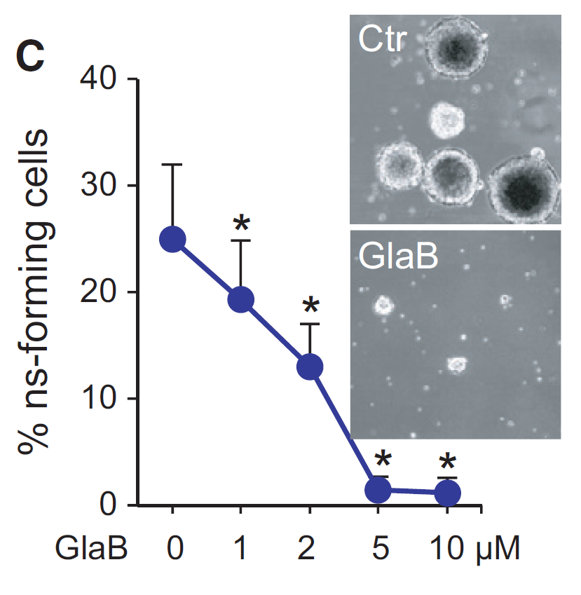
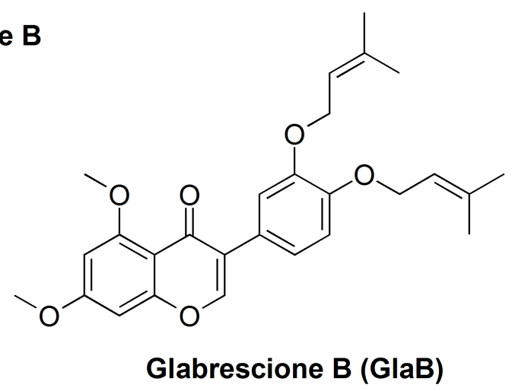
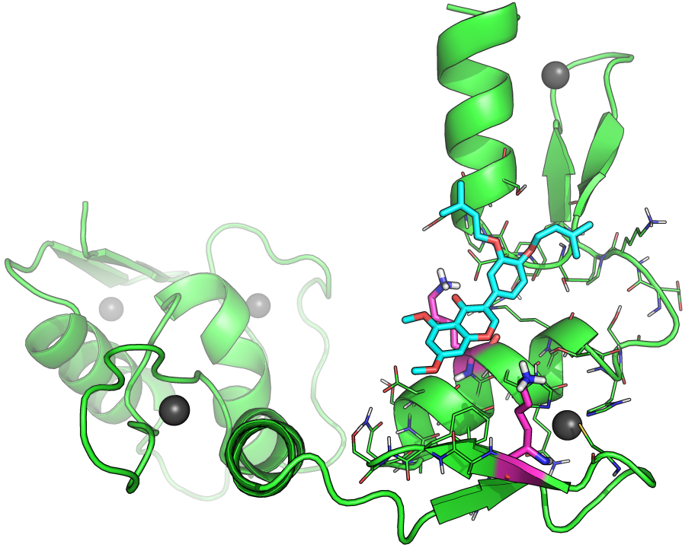
GlaB inhibits Gli1/DNA interaction in vitro and in vivo
EMBOJ (2015) 34(2):200-17.

Slide 18
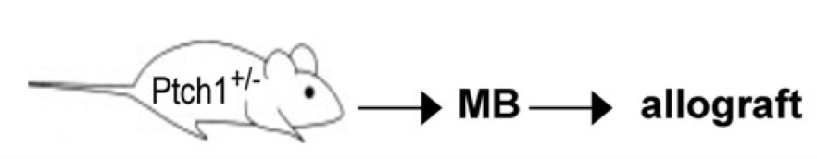
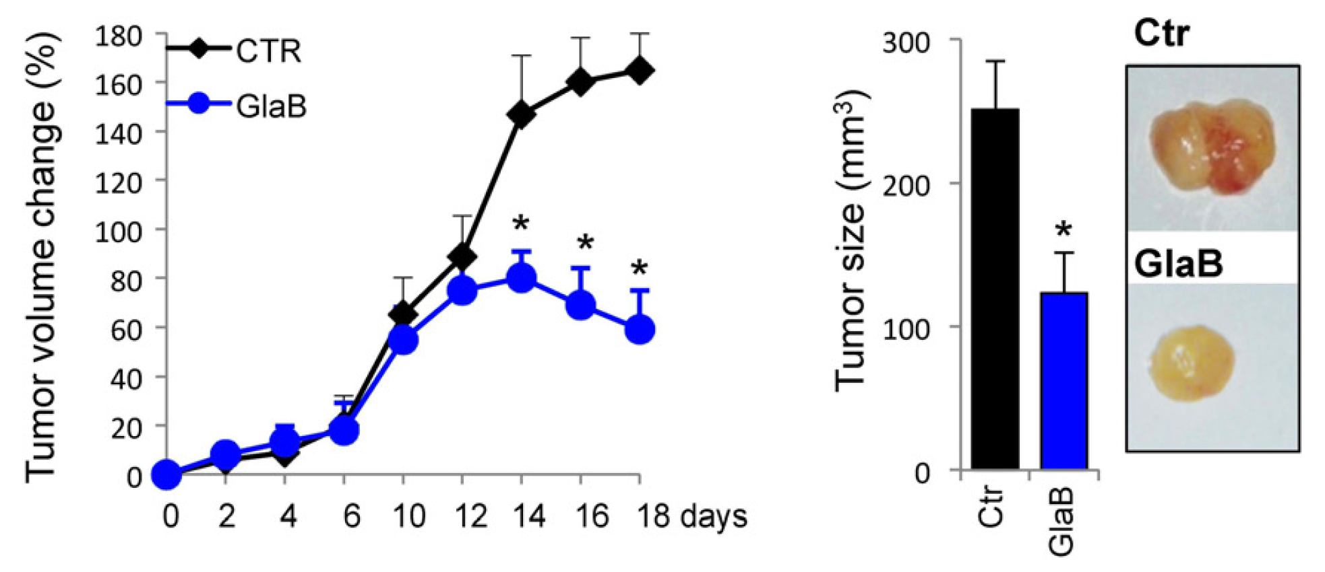
GlaB efficacy in vivo (Ptch1^{+/-} MB allografts)
MB CSCs
30 mg/Kg
… MB orthotopic xenograft animal model confirmed the efficacy of GlaB in vivo (GlaB crosses of mice BBB)
Preclinical studies in GLP are running….
EMBOJ (2015) 34(2):200-17
WO 2014207069

Slide 19
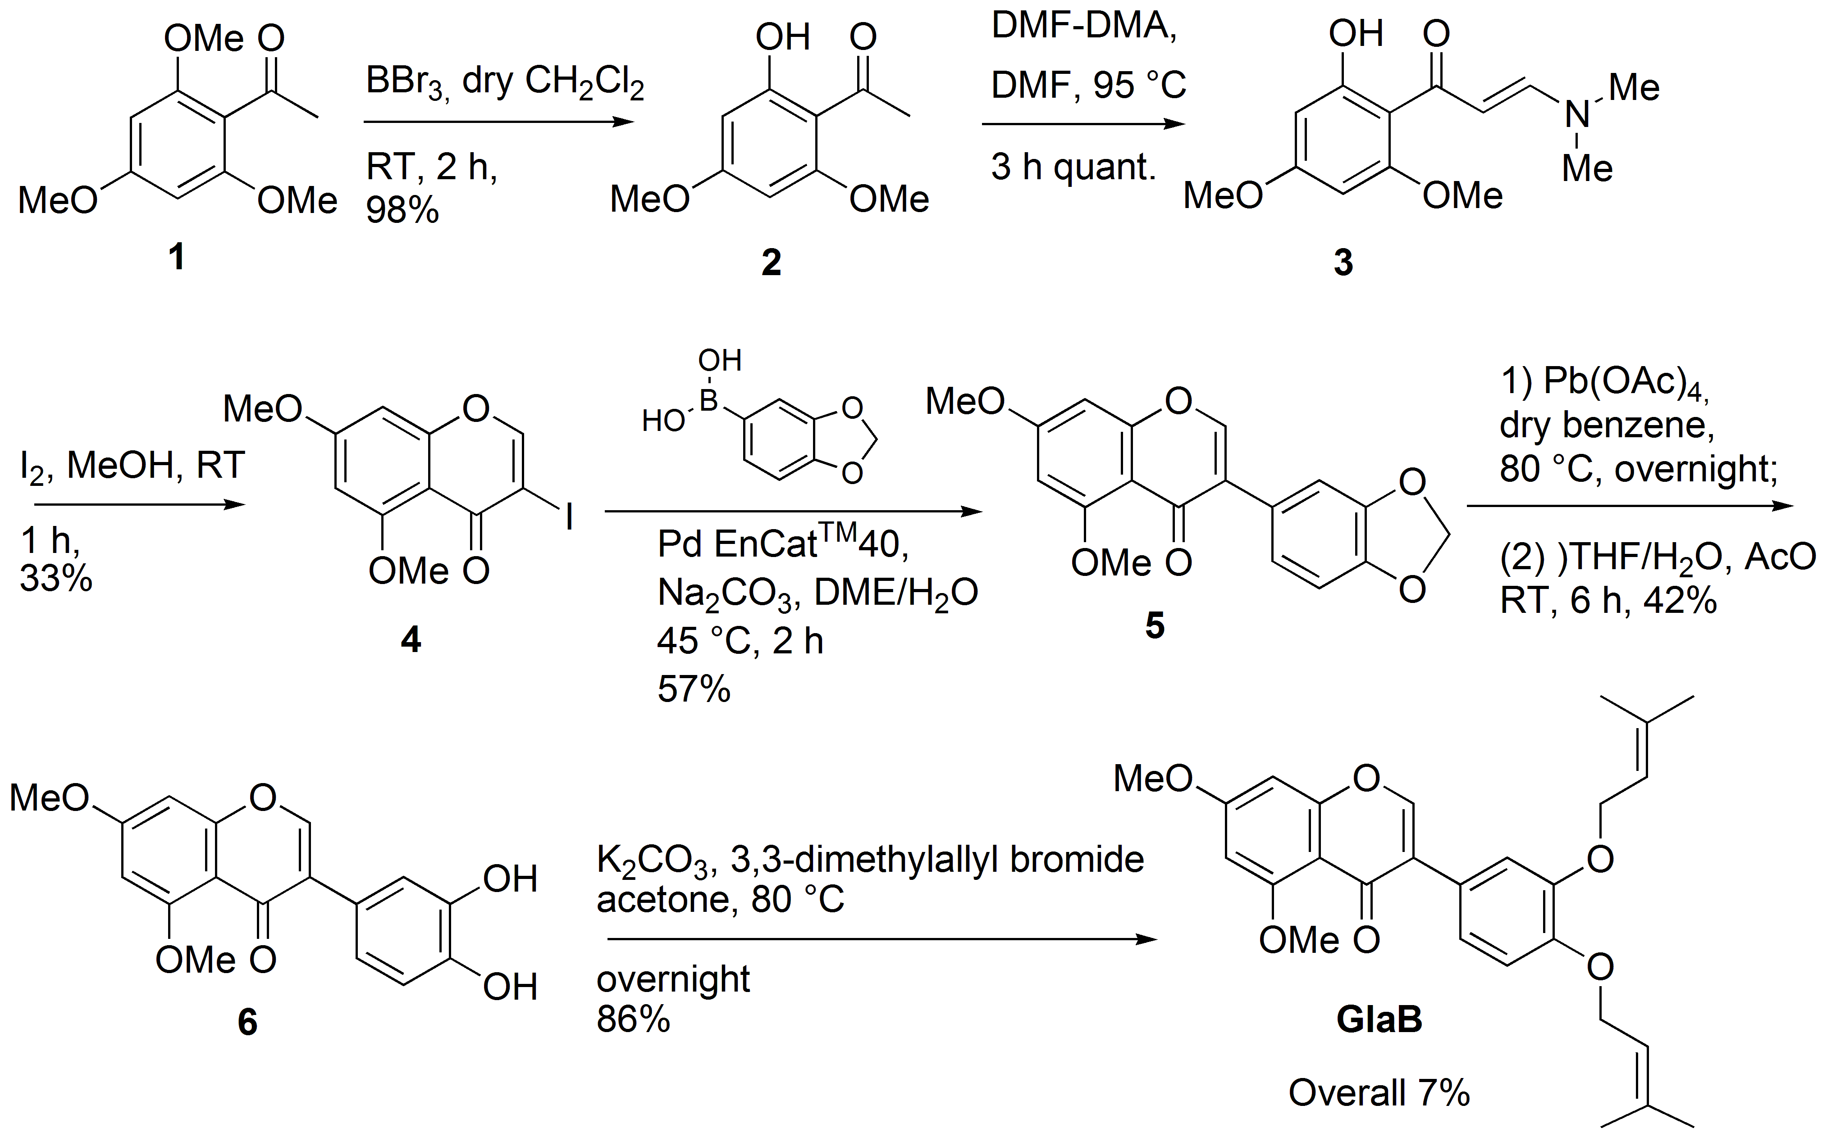
GlaB total synthesis

Slide 20
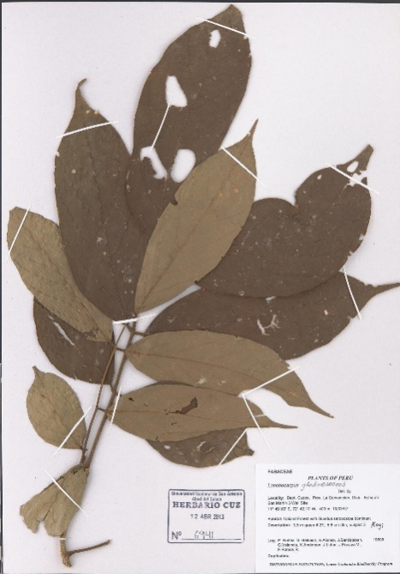
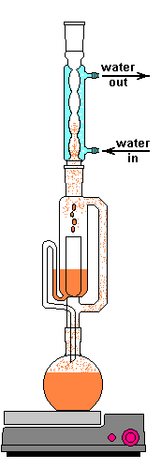
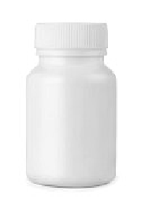

Derris
Glabrescens
Seeds extraction
soxhlet
MeOH
Products isolation
silica-gel chromatography
5% AcOEt/benzene
total synthesis
GlaB
^{Capsules}
Glabrescione B
0,3%
100 mg

Slide 21
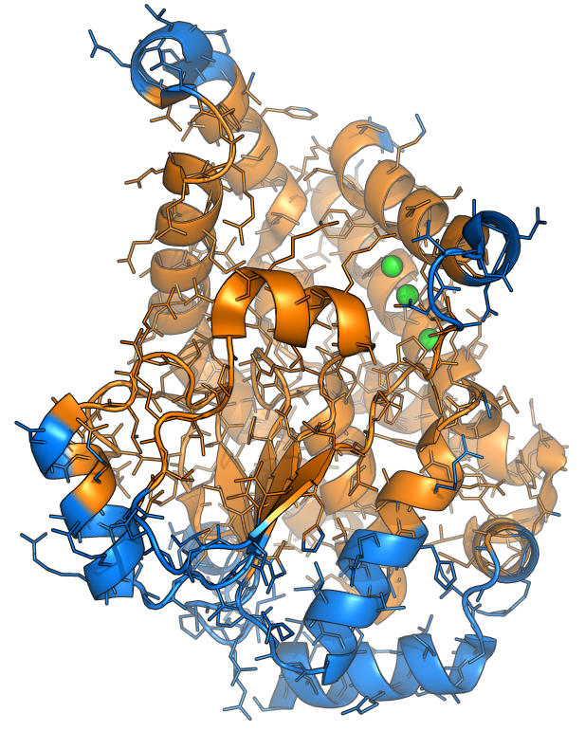
Example of Structure-based approach – Mtb PtpB inhibition
Natural products library
(in house)
850 ca molecules
DOCKING
Free Energy calculations
Mtb PtpB
Kuwanones
Mascarello et al. PLoS One. 2013;8(10):e77081

Slide 22
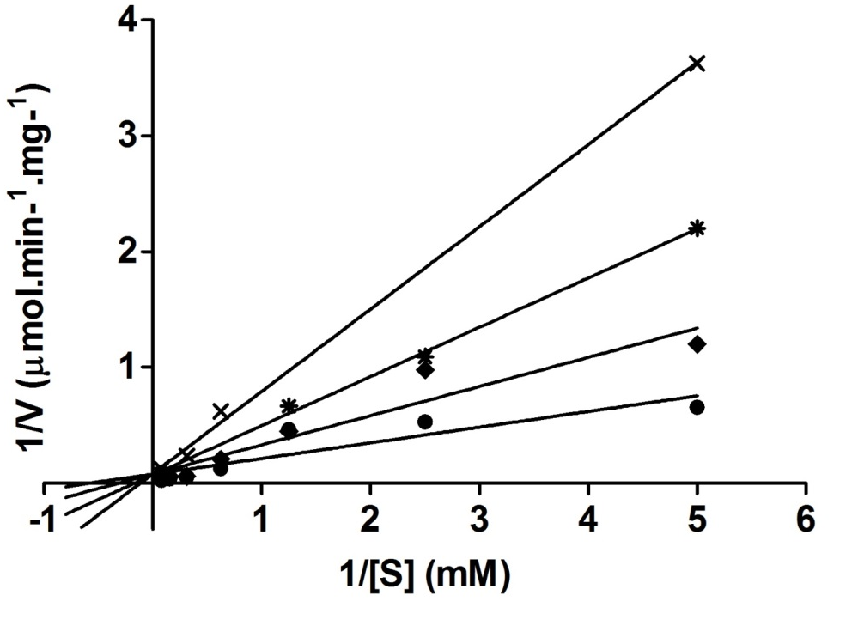
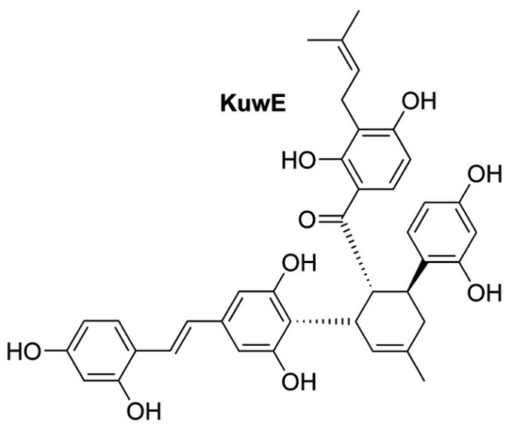
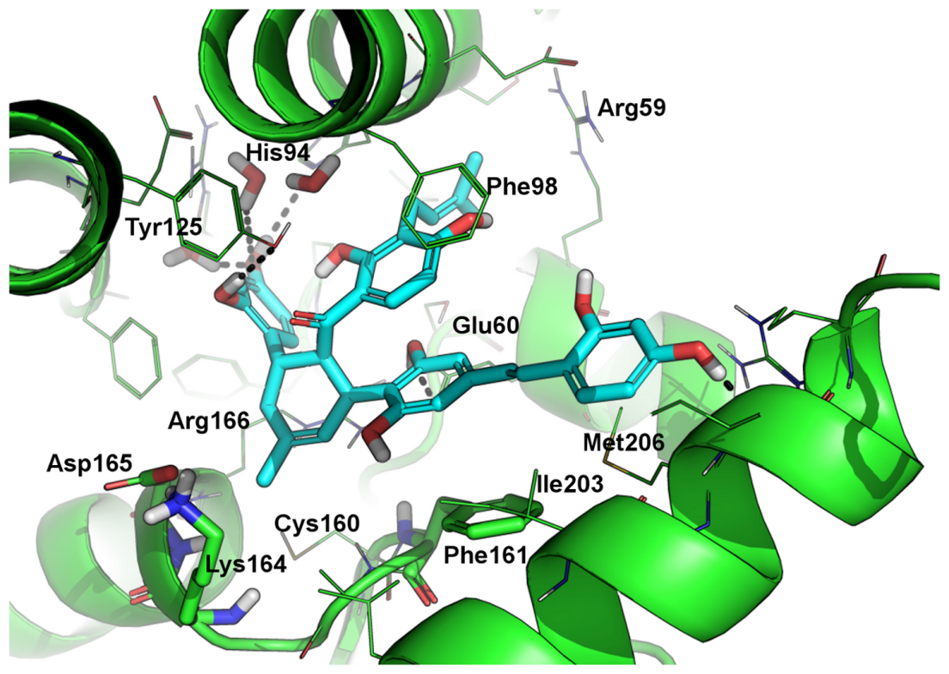
0 µM (), 1 µM (), 3 µM (→), 6 µM ();
pNPP substrate
IC₅₀ = 1.9 ± 0.5 µM
(Ki = 1.6 ± 0.1 µM)
Kuw-E is a COMPETITIVE inhibitor of mPtpB
Mascarello et al. PLoS One. 2013;8(10):e77081

Slide 23
Example of Ligand-based approach
Aim: targeting the Notch3 signaling pathway
Note: there are no structure of Notch3 targets available in the Protein Data Bank.
→ In vitro screening may be preferred to computational screening. However, HTS are generally time and cost consuming and should deal with false positives.

Slide 24
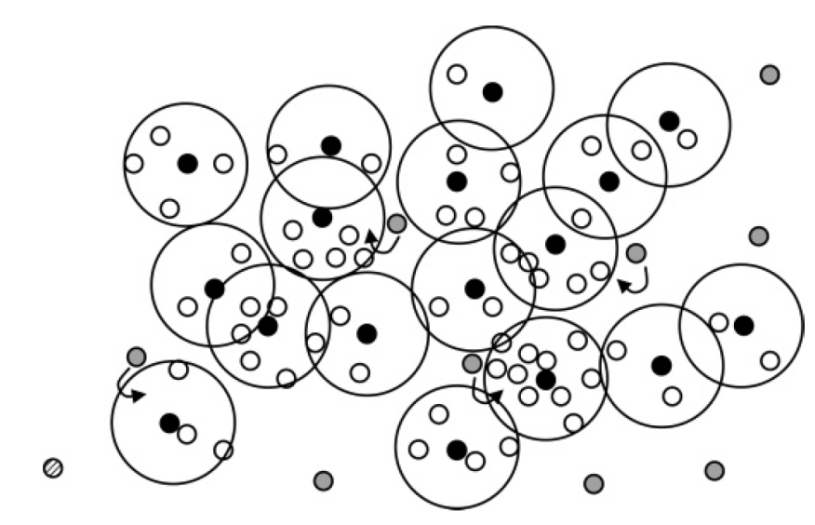
How is it possible to concentrate in vitro efforts only to a limited number of representative compounds?
To cluster a compounds library based on molecule’s common chemical structure (Fingerprints comparison) and to select the cluster’s head as the most representative molecule for each cluster
Mauser H, J Chem Inf Model 2005, 45, 542-548

Slide 25

Clusterization of the whole library
Clusters
Cluster representative
Molecules of the cluster

Slide 26
Cluster Representatives – TESTED AT ROUND #1
POSITIVE HITS
ACTIVE AT ROUND #1

Slide 27
Clusters – TESTED AT ROUND 2
ALKALOIDS
CHALCONES
COUMARINS
CLUSTERS OF THE REPRESENTATIVE BIOACTIVE LEADS
Structure-Activity Relationships (SAR)
Hints for Lead Optimization

Slide 28
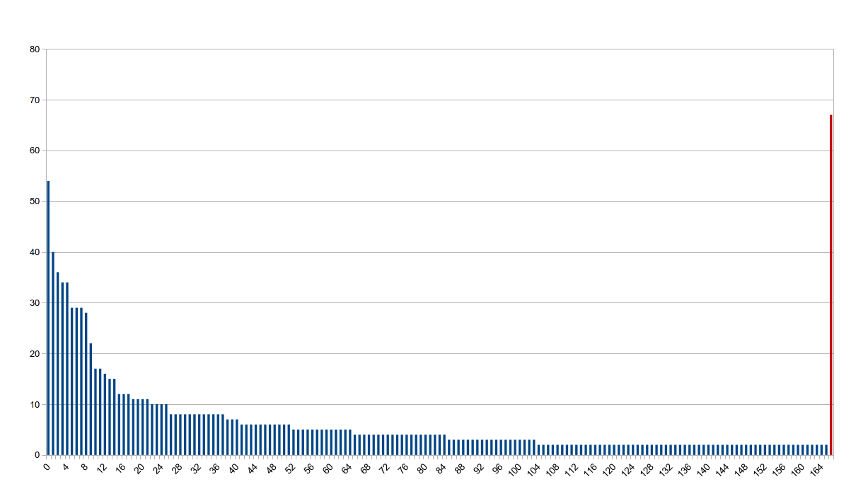
Clustering of an in house Natural Products library
# mols in cluster
# clusters
Fingerprint: TREE (OpenEye)
Tanimoto CutOff: 0.5

Slide 29
10 Most Populated Clusters of Natural Compounds

Slide 30
Anti-proliferative effects
Human T-ALL cell line (Molt-3)
Cell viability
0 h 24 h 48 h 72 h tempo in ore
Compounds were first tested for their anti-proliferative effect on Molt3 cells

Slide 31
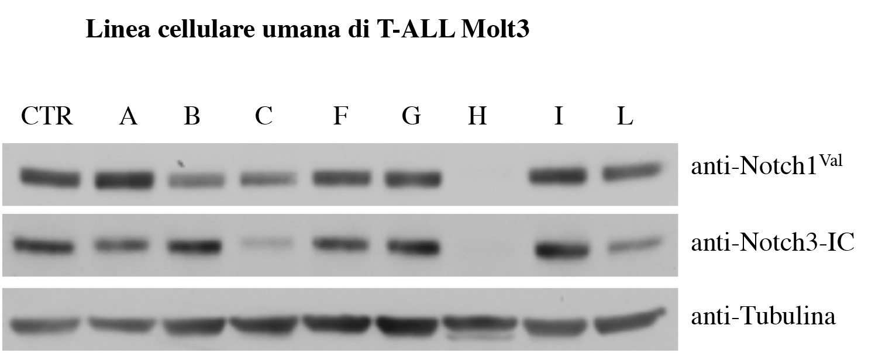
Notch3 modulation
Human T-ALL cell line (Molt-3)
Compounds able to inhibit Molt-3 proliferation and to modulate Notch3 signaling (C, H, L) were classified as POSITIVE LEADS.
Respective clusters of positive leads were tested to afford SAR and to drive lead optimization.

Slide 32
NOTCH3 modulators under development

Slide 33
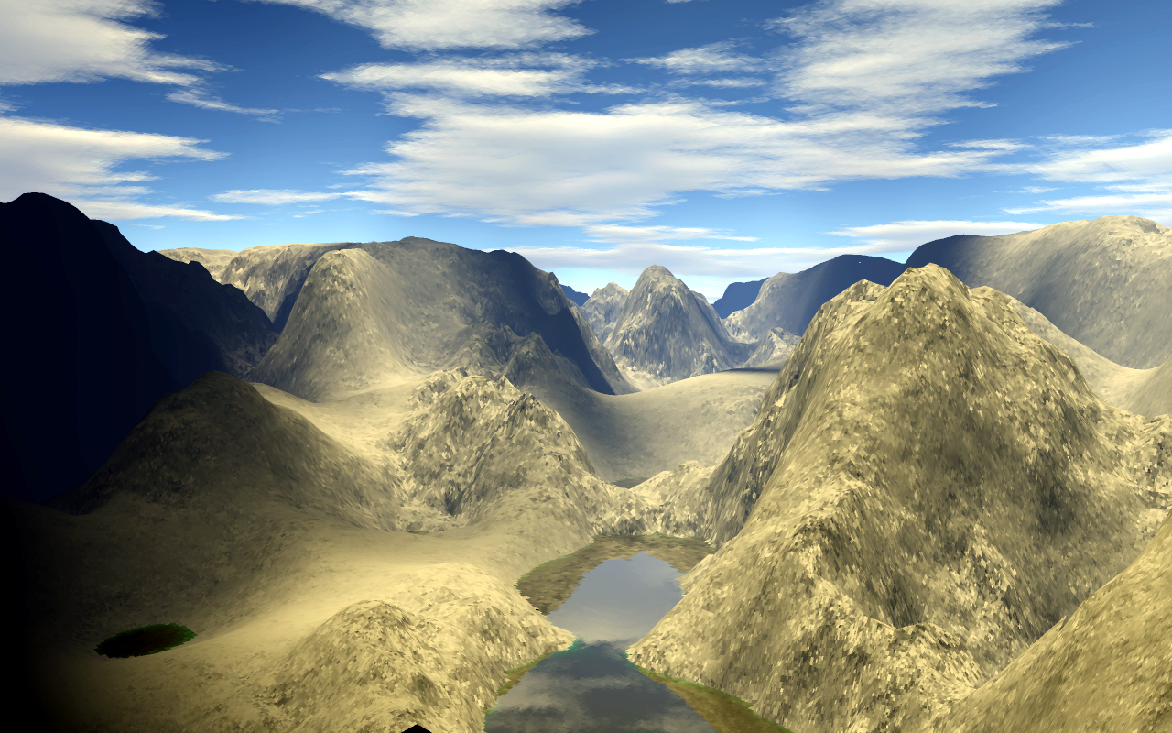

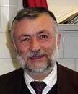
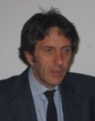
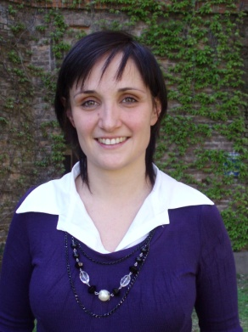
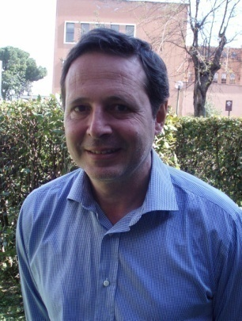
Scientists at MoLiRom
Bruno Botta, PhD
Professor of Organic Chemistry
Email: bruno.botta@uniroma1.it
Francesco Gasparrini, PhD
Professor of Organic Chemistry
Email: francesco.gasparrini@uniroma1.it
Claudio Villani, PhD
Professor of Organic Chemistry
Email: claudio.villani@uniroma1.it
Alessandra Bonamore, PhD
Research fellow in Molecular Biology, Email: alessandra.bonamore@uniroma1.it
Alberto Boffi, MD
Professor of Molecular Biology
Email: alberto.boffi@uniroma1.it

